Slide 1
Containerization as an Open Science tool

Slide 2
Why should I even listen to you?
Disclaimer: like the other Nicolas, but worse:
Master’s degree in Computer Science with a focus on Software Architecture
But not a PhD, scientist or researcher in any way
But a frequent user of containerization for:
Cloud service development
DevOps (CI/CD) pipelines
Internal tooling
General “I like to experiment without blowing up my dev environment”
Containers made my job easier; maybe they can help you too?
Notes:
Introduction
Mention this talk is my own and is not related to my employer
Set expectations. We’ll talk about:
Why you might want to use containers
How they solve open science problems
What other types of problems they might be useful for
How to use them in practice
We WON’T talk about:
Higher level tools (orchestration)
Details of using the Docker CLI

Slide 3
What problem are we even solving?

Slide 4

Has this happened to you?
You want to run existing code you didn’t write and you’d like.
Ideally, I would just start project.sh and have it spit out some results…
Oh, this project has no documentation on how to build or install it. Or launch it.
Or it does, but the documentation is out of date and following exactly fails!
Well, I just need to install this one <library / Python package / driver> to get it to work, this should be easy…
I finally got it working. It would be nice if this was easier next time!

Slide 5
The four problems we’re solving
Ease of use: starting the project should be a single command
Documentation: instructions to build and run the project should be a machine readable recipe that generate some sort of executable “wrapper”
Dependency hell: solving dependencies should be expressed explicitly in the recipe; the recipe should be repeatable across time and environments
Archival: Once the project has been “wrapped”, it should be archived as a container for later use without rebuilding
Ease of use: starting the project should be a single command
Documentation: instructions to build and run the project should be a machine readable recipe that generate containers
Dependency hell: solving dependencies should be expressed explicitly in the recipe; the recipe should be repeatable across time and environments
Archival: Once the project has been containerized, it should be archived as a container for later use without rebuilding

Slide 6
Wait, what even are containers anyway?
An OS level virtualization technology offering:
Process space isolation
Network isolation
File system isolation
Performance
A set of tools define, share, run, and manage container blueprints (“images”) and containers:
Images are defined in a human readable, machine executable format
Images can be shared as pre-built binary blobs with efficient storage and distribution
Containers can easily be spawned from images and are transient
Notes:
Performance: a container is, fundamentally, just a process
OS native technology (LXC, under Linux)
From the inside, a container looks reasonably like a VM or bare metal

Slide 7
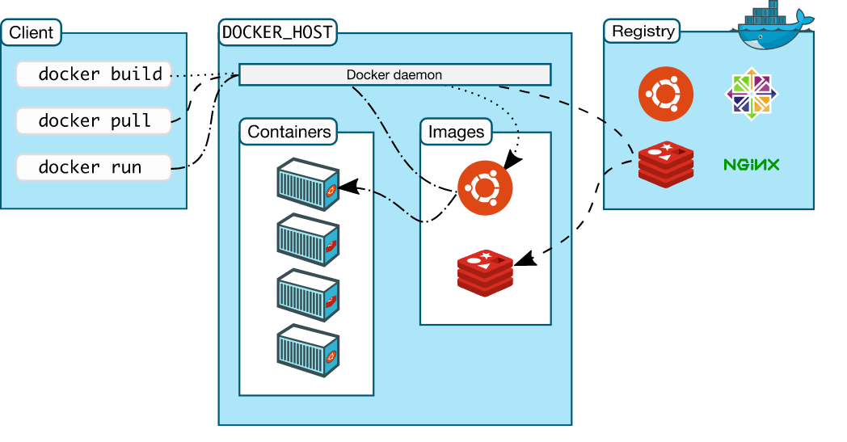
A brief terminology detour
Containers are the running processes and their isolation wrapper
Images are binary blobs to be instantiated as containers
Registries store images
Container runtimes build, upload, download, and run containers

Slide 8
So how do containers solve our problems?
Ease of use:
Simple command line interface to download and run a container image
Options to customize runtime behavior
Documentation:
Container images are created from text based definitions
These act as living documentation of how to build and run a project
They can be version controlled
Dependency hell:
Image definitions are not a silver bullet => you’ll still need to solve the problem…
But you’ll only be solving it once, and you’ll be documenting how while you do it
Archival:
Image registries store built images for future use
Registries are effective at distributing (potentially large) images
Registries integrate well with CI/CD tools for automated archival

Slide 9
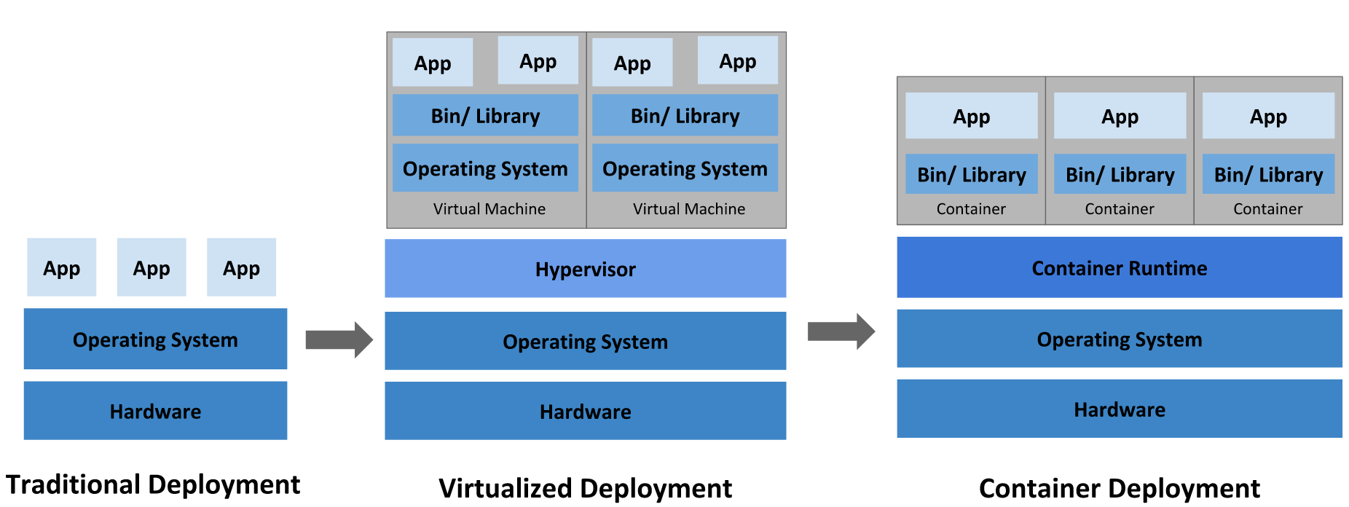
What other problems are people solving?
Across the software industry, containers are useful for:
Isolation
Continuous Deployment
Reliability
Notes:
Source: Google (https://kubernetes.io/docs/concepts/overview/what-is-kubernetes/)
Containers are an evolution of existing deployment models and naturally result from the historical progression from individual servers to VMs onwards.
Containers are “cattle, not pets”: is an application fails or misbehaves, it can be restarted transparently (in theory)
In these models:
Bare metal deployment: if an app goes down, it’s an annoyance, and possibly a manual process to restart it. If the OS or hardware go down, it’s a disaster
VM deployment: if the OS goes down, the hypervisor can automatically restart it; if the app goes down, still possibly a manual process
Container deployment: if a container goes down, the container runtime can restart it, restarting the app cleanly. Containers can be killed and replaced whenever needed

Slide 10
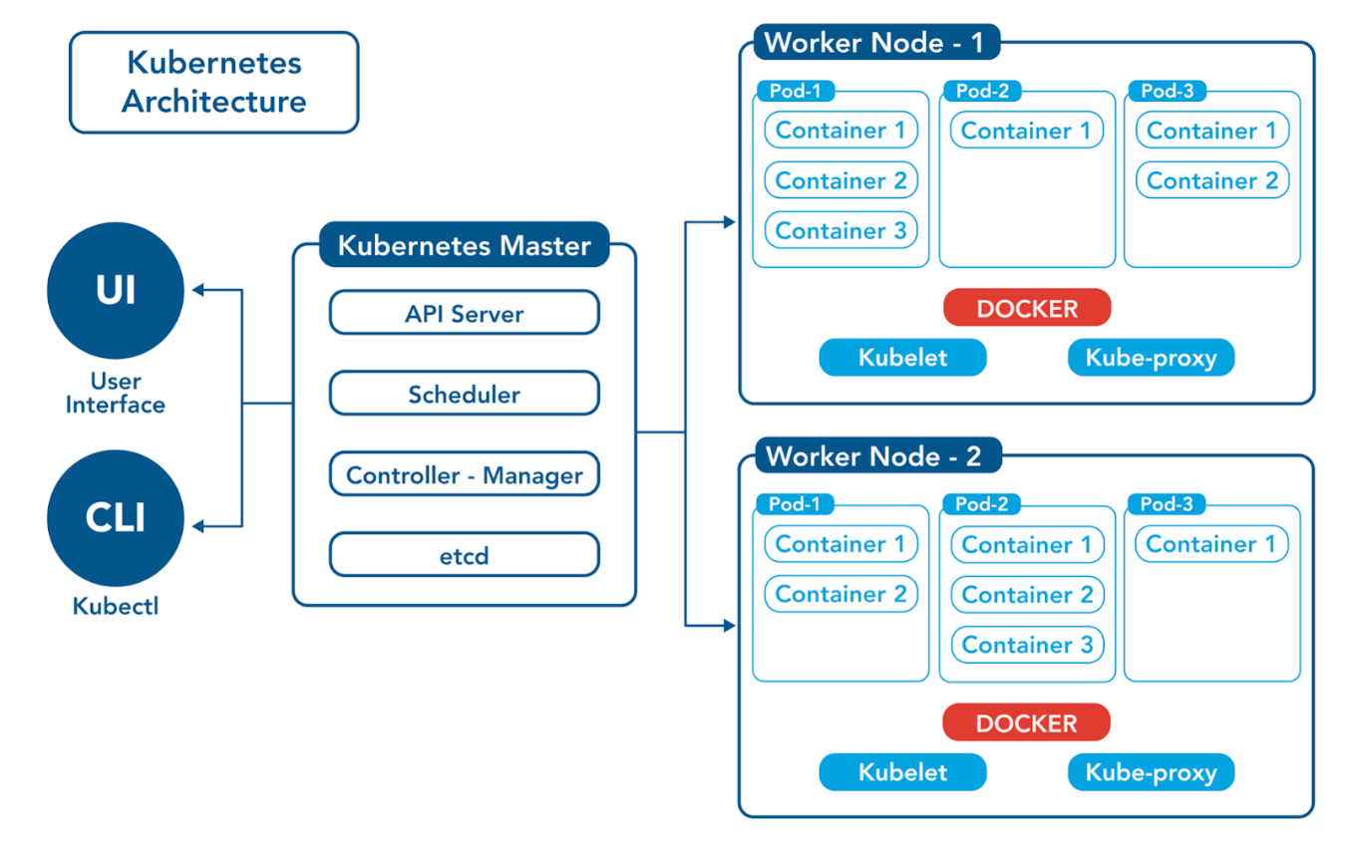
What will containers NOT do for me?
Containers are a tiny part of a broader ecosystem
In large projects, multiple containers might form higher level components (apps, services, etc)
Defining relationships between containers (dependencies, communication, co-location, etc.) is outside the scope of a container runtime
All of this is a job for container orchestration
… but you probably don’t need it

Slide 11
How do I actually use this?

Slide 12
Running an existing container
Install a container runtime (i.e. install Docker Desktop, probably)
docker run hello_world
docker run ghcr.io/ezekiel-da/deepdream_demo
docker run ghcr.io/ezekiel-da/deepdream_demo -v <some_folder>:/data

Slide 13
Building and publishing a container image
Define your Dockerfile
docker build . -t <image_name>
docker push <image_name>

Slide 14
Demo

Slide 15
Questions

Slide 16
Thank you!

Slide 17
FAQs
What about Windows?
Docker vs containers (OCI)

Slide 18
Links
https://opencontainers.org/
https://www.docker.com/
https://podman.io/
https://github.com/Ezekiel-DA/containerization_example
https://reproducible-analysis-workshop.readthedocs.io/en/latest/8.Intro-Docker.html
Carl Boettiger (2015), An introduction to Docker for reproducible research, with examples from the R environment, ACM SIGOPS Operating Systems Review, Special Issue on Repeatability and Sharing of Experimental Artifacts. 49(1), 71-79, doi: 10.1145/2723872.2723882

